Slide 1
Analysis of Country’s Life Expectancy
ISYE 6414 Regression Analysis
Team 9: Jinglin Xu, Jingyi Chen, Yunpu Zeng, Renato Maynard Etchepare, Yang Lu

Slide 2
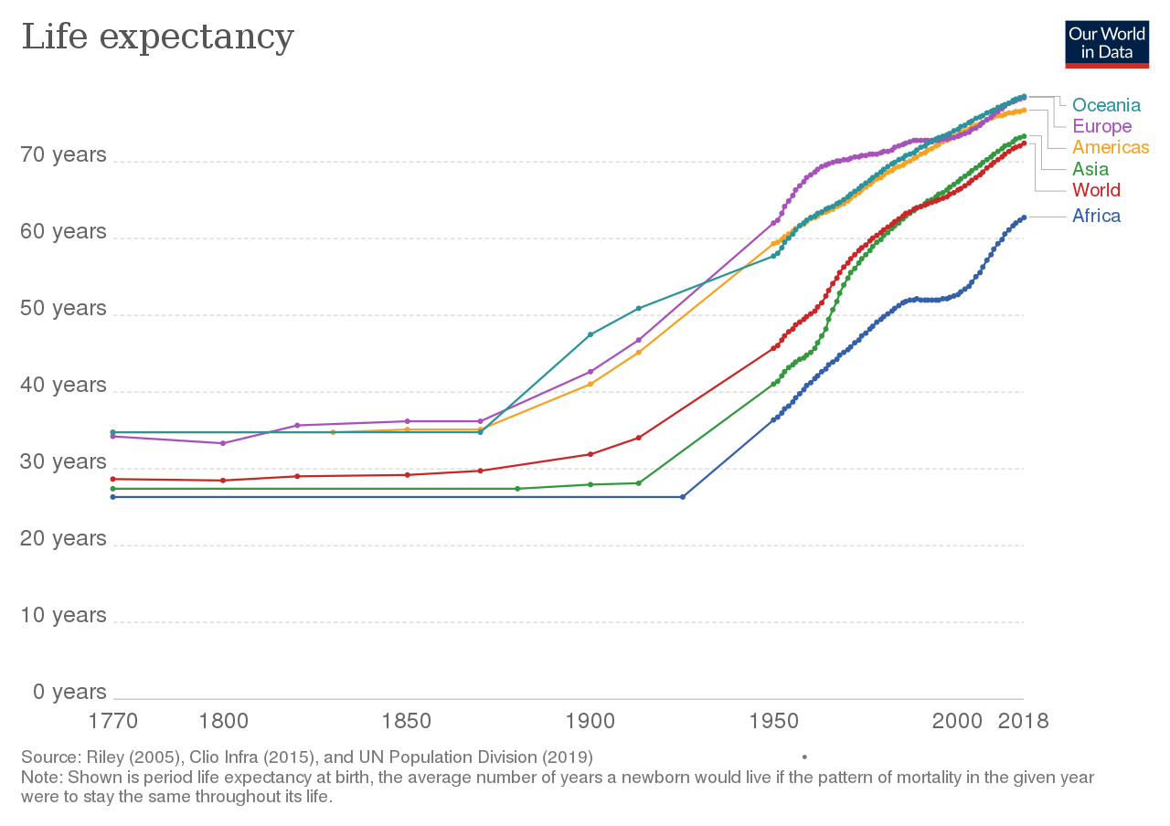
Introduction
“Life expectancy has increased by over 6 years globally since 2000”
Why is our topic important?
Economic planning
Public health policies
Social services
Notes:
Between the years 2000 and 2019, global life expectancy at birth rose from 66.8 years to 73.4 years, marking an improvement of more than 6 years. That really made us think what are the dominant factors behind this fact over time.

Slide 3
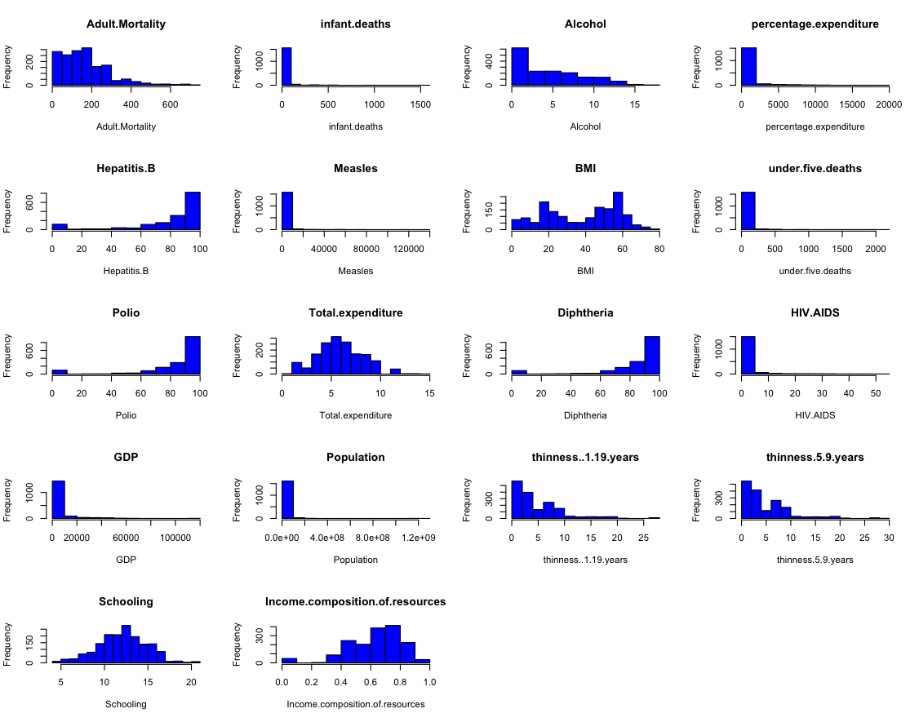

Data exploration and description
The original data set has 22 columns, setting Life expectancy as our dependent variable
20 others as predictors
Categorical:
Country, Status
Quantitative
Years of Schooling
BMI
GDP
Etc..
Removed all rows with missing values
1649 rows
Transformation
needed!
Notes:
The original dataset has 22 columns thus variables. We set Life expectancy as our dependent variable. We exclude `Year` from our analysis so there will be other 20 variables which are our predictors; two of them are categorical and the rest are quantitative.
Country has been changed to Continent to avoid multicollinearity problem and reduce model complexity.
Here is a histogram for our quantitative predictors’ distribution. As we can see here, it is very obvious that many predictors are skewed. So we do need transformation on the them.
Excluded year

Slide 4

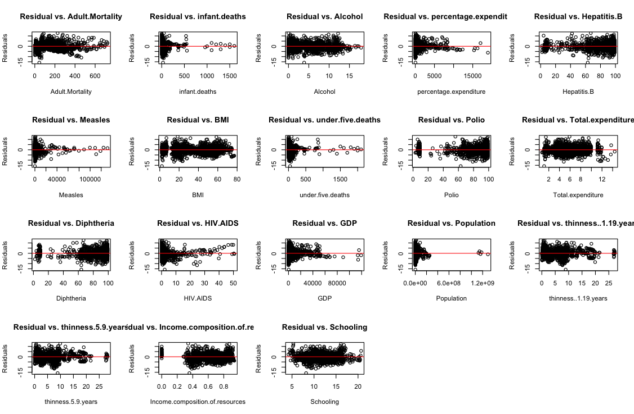
Data exploration and description
Transformation
needed!
Notes:
This just showed us we need further transformation again.

Slide 5
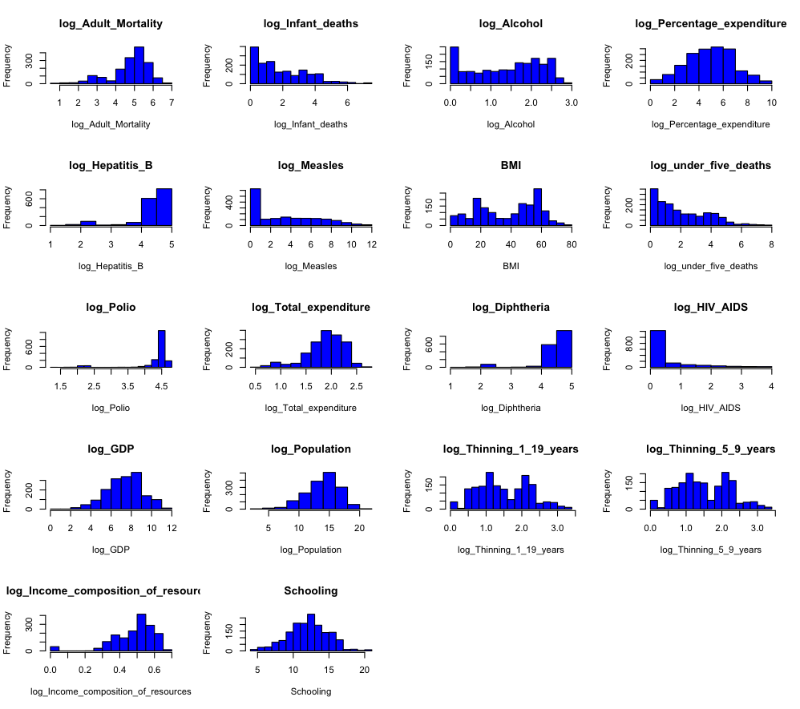
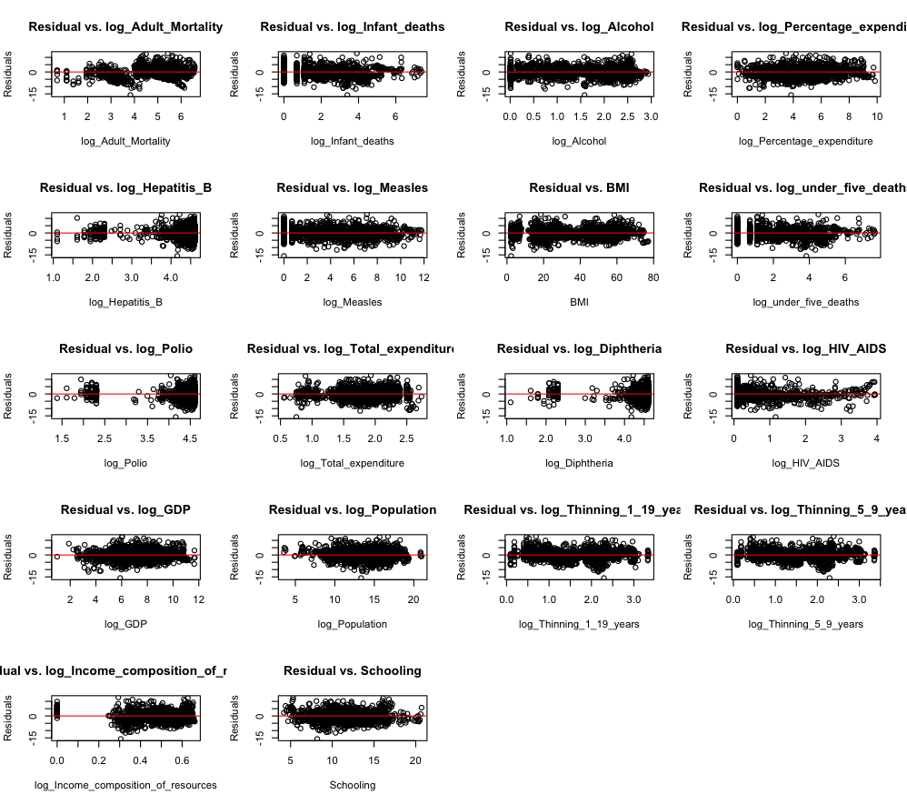
After Log Transformation

Slide 6
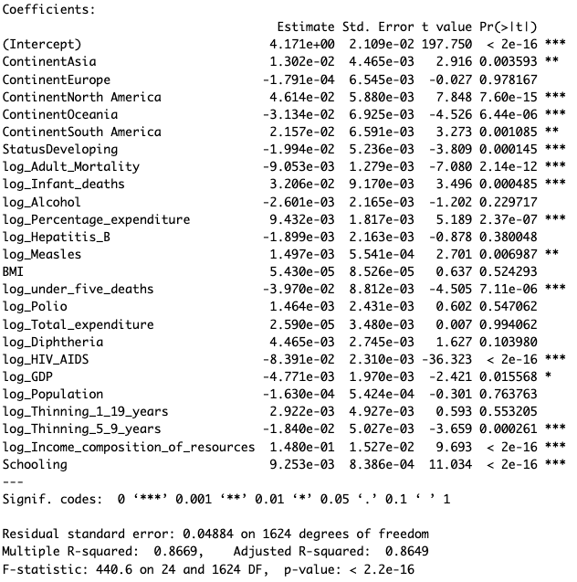
Initial Model with Selected log Transformation
model_trans <- lm(log_Life_expectancy ~ Continent + Status + log_Adult_Mortality + log_Infant_deaths + log_Alcohol + log_Percentage_expenditure + log_Hepatitis_B + log_Measles + BMI + log_under_five_deaths + log_Polio + log_Total_expenditure + log_Diphtheria + log_HIV_AIDS + log_GDP + log_Population + log_Thinning_1_19_years + log_Thinning_5_9_years + log_Income_composition_of_resources + Schooling)
Baseline: ContinentAfrica; StatusDeveloped

Slide 7
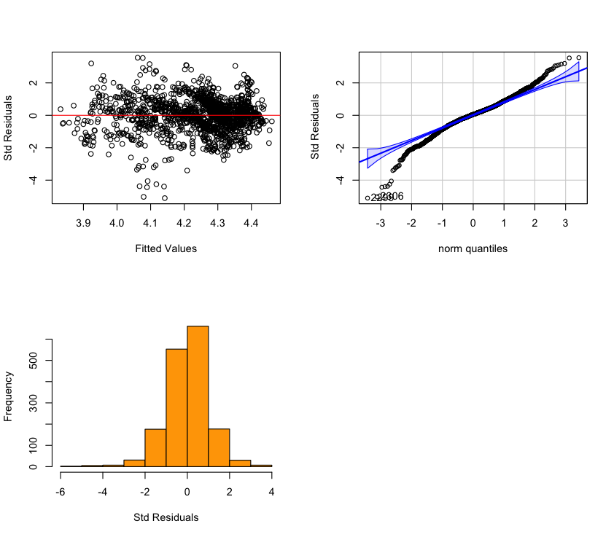
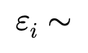
Goodness of fit
1.Linearity
2.Constant Variance
3.Independence
4. Normal for confidence/prediction intervals

Slide 8
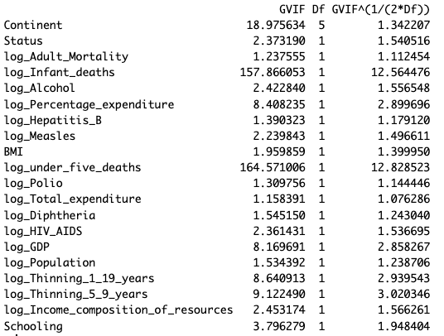
Multicollinearity
All variables’ VIF should be less than Max(10, 1/(1-R^2))
After checking, we removed log_under_five_deaths

Slide 9
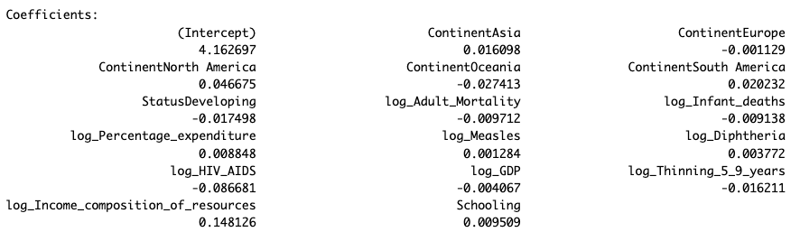
Variable selection - Bidirectional Stepwise Selection
bidirect_model <- stepAIC(model_trans, direction = "both", trace = FALSE)
summary(bidirect_model)
bidirect_model <- lm(log_Life_expectancy ~ Continent + Status + log_Adult_Mortality + log_Infant_deaths + log_Percentage_expenditure + BMI + log_Diphtheria + log_HIV_AIDS + log_GDP +
log_Population + log_Thinning_5_9_years + log_Income_composition_of_resources + Schooling)

Slide 10
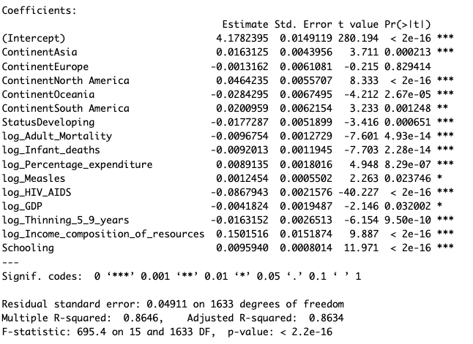
Variable selection - using p-values
p_val_model <- lm(log_life_expectancy ~ Continent + Status + log_Adult_Mortality + Infant_deaths + log_Percentage_expenditure + log_Measles + log_HIV_AIDS + log_GDP + log_Thinning_5_9_years + log_Income_composition_of_resources + Schooling)
Bidirectional AIC: -5242.272
P-value AIC:
-5241.612

Slide 11
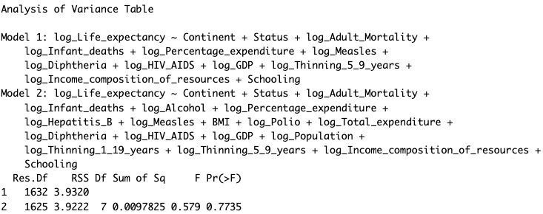
ANOVA
P-val > 0.05; the null hypothesis (that the simpler model is adequate) cannot be rejected
We selected the reduced model (Model 1)

Slide 12
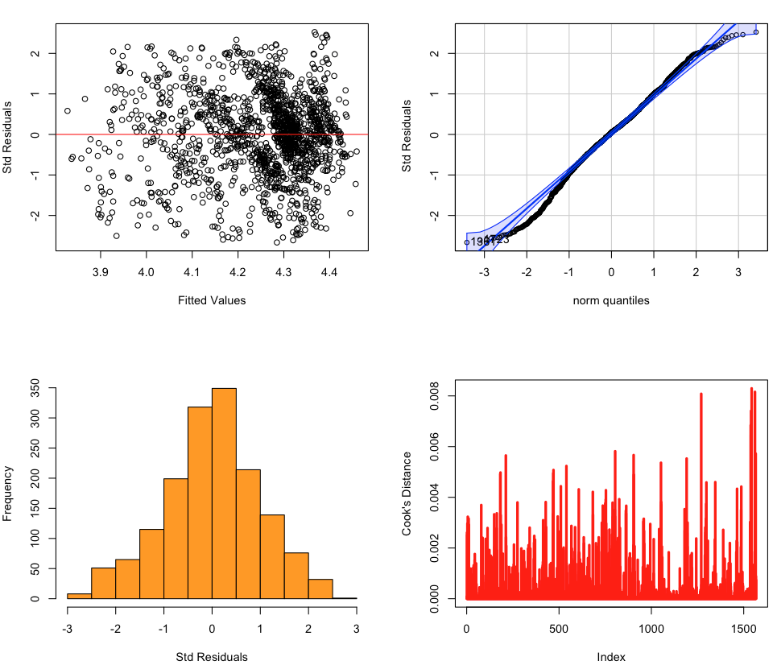



Model Evaluation
Assumptions
1.Linearity
2.Constant Variance
3.Independence
4. Normal for confidence/prediction intervals
Title Goes Here
Outliers
1.Cook’s Distance & Std Residuals
After check, total 79 outliers removed
All assumptions are held. There is three observations with a Cook’s Distance noticeably higher than the other observations. However, its Cook’s distance is close to 0.004, suggesting that there are likely no outliers.

Slide 13
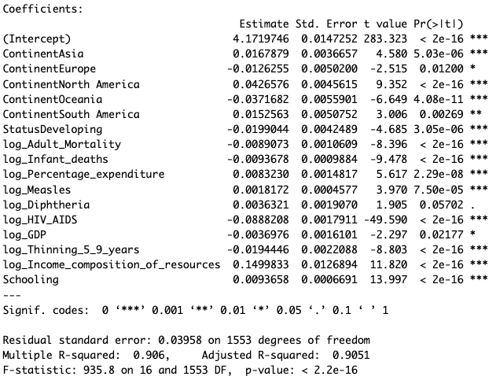

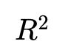
Model Evaluation
Model Performances
Title Goes Here
1.
2. MSE
3. F-test for overall regression
90.60% of total variability in life expectancy that can be explained by the regression

Slide 14
Model Evaluation
Model prediction
Data Splitting: k-fold cross-validation (KCV)
k =10
Model Prediction
Model Accuracy
Mean squared prediction error (MSPE)
Mean absolute prediction errors (MAE)
Mean absolute percentage error (MAPE)

Slide 15
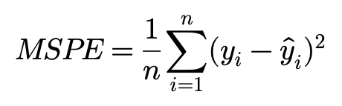
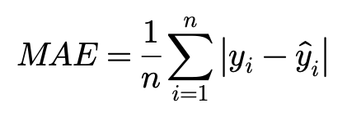
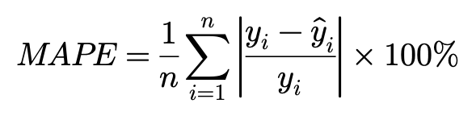
Model Evaluation
Model prediction
Model Accuracy
 | Model Accuracy
MSPE | 0.0015
MAE | 0.0308
MAPE | 0.7305

Slide 16
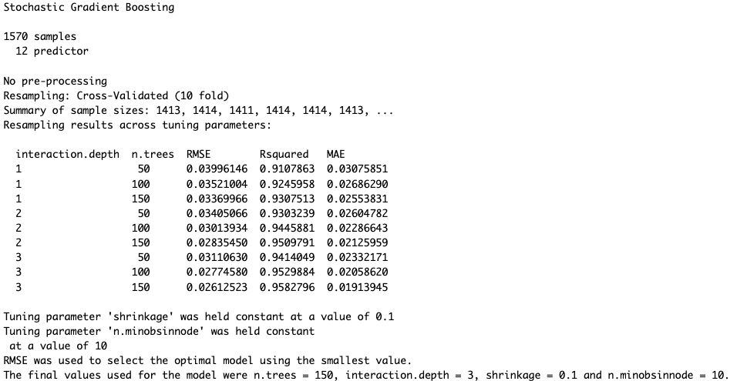
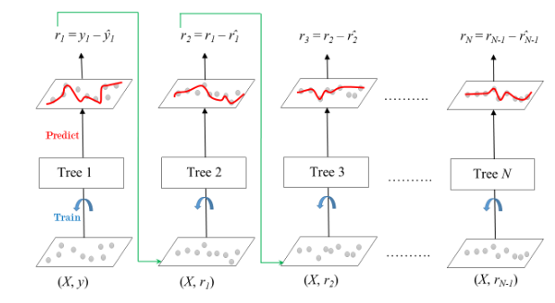
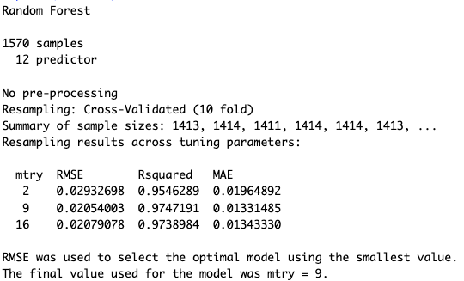
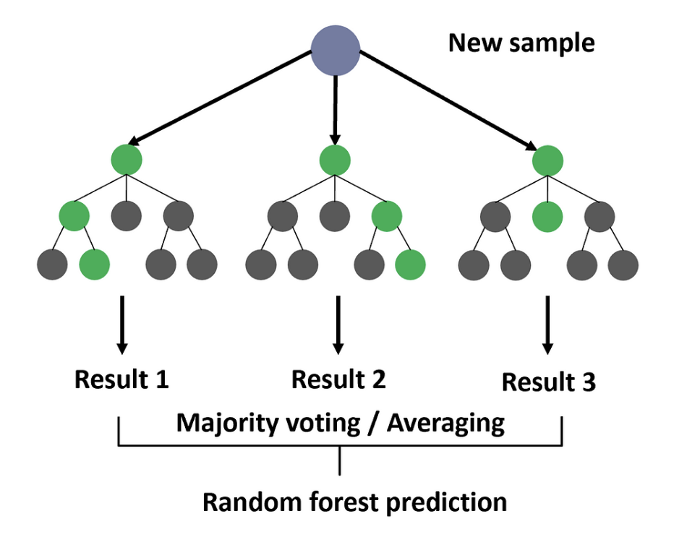
Model Comparison
ML Models
Gradient Boosting method
Random Forest method

Slide 17
Model Comparison
Model Prediction Accuracy
 | MLR | Gradient Boosting | Random Forest
MSPE | 0.0015 | 0.000487 | 7.2618e-05
MAE | 0.0308 | 0.01646 | 0.00538
MAPE | 0.7305 | 0.38906 | 0.12763
Generally, the prediction performances of random forest method is the best among the three models. However, the ML methods may encounter overfitting issue and are less interpretable.

Slide 18
Prediction on Life Expectancy
(continent: North America)
Where
Predictor~ Status= “developed”
The rest of the predictors~ median(df$predictors)
Model | Life Expectancy
MLR | 77.4
Gradient Boosting | 74.3
Random Forest | 73.7
Results

Slide 19
Conclusion
Public Health resources > Economic planning > Social services
Compare to economic and social factors, predictors like adult mortality and HIV/AIDS prevalence are strongly associated with life expectancy, suggesting that investing in health systems and disease prevention could substantially improve longevity of a country.
Positive associations with schooling and income distribution emphasize the importance of education and equitable resource allocation in supporting public health outcomes.
Policymakers should prioritize public health infrastructure and education to achieve the greatest benefits in life expectancy

